Slide 1


Biosimilars and Monoclonals
A TALK AT CIPT & AHS, ULUBERIA

Slide 2
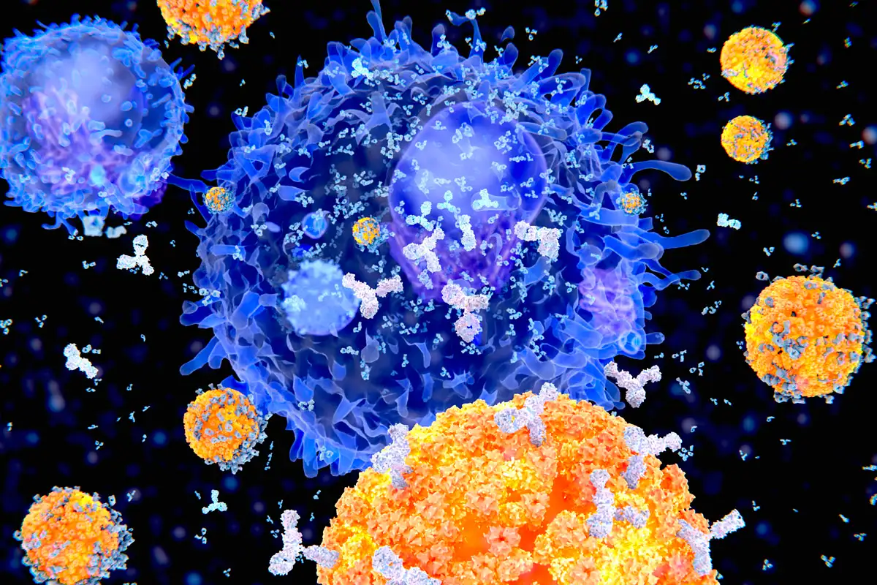
B-CELL AND ANTIBODY
Notes:
https://www.newscientist.com/definition/antibodies/

Slide 3
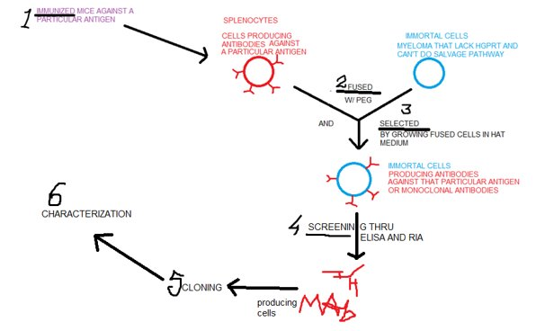
HYBRIDOMA/MAbs

Slide 4
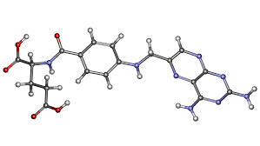
AMINOPTERIN
Notes:
By Jü - Own work, Public Domain, https://commons.wikimedia.org/w/index.php?curid=65923386

Slide 5
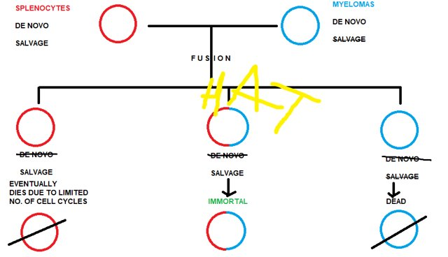
SURVIVAL

Slide 6
APPLICATIONS
Treatment of cancer.
Distinguishing between different sorts of leukaemia.
Detection of cluster of differentiation markers on cell surface.
FACS. And flow cytometry.
Treatment of autoimmune diseases.

Slide 7
THIS PRESENTATION WAS PREPARED BY
MR. SUKARNA BASU
Topic(s) covered:
Hybridoma technology
While every effort has been made to attribute images to their creator(s) oversights can please be communicated at sukarnadotbasu@gmail.com for correction.

