Slide 1
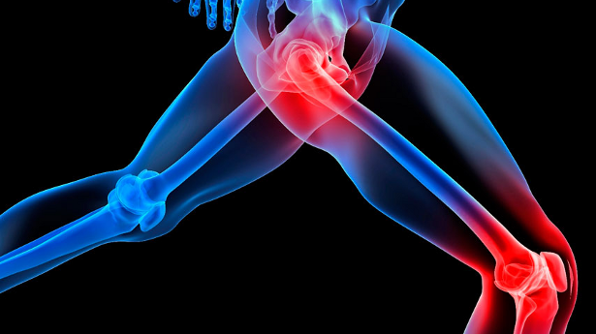

A CASE STUDY ON GOUTY ARTHRITIS
Presented by:
Krishnendu Ray
Assistant Professor

Slide 2
PATIENT DETAILS:
A 33 years old male patient was admitted on general medicine ward on 13-11-19 and got discharged on 15-11-19 and the length of the stay of the patient was 3 days.

Slide 3
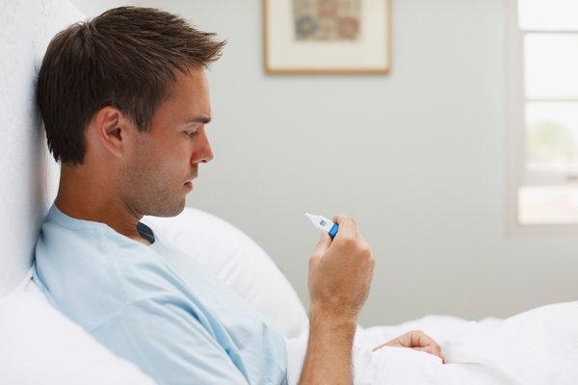
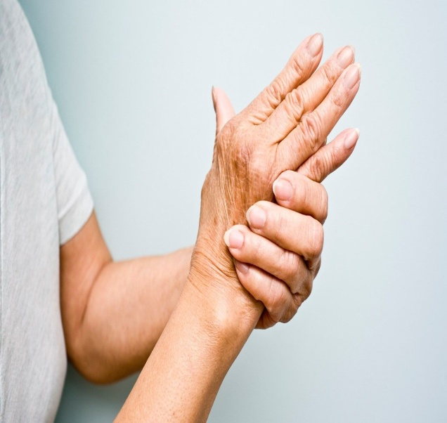
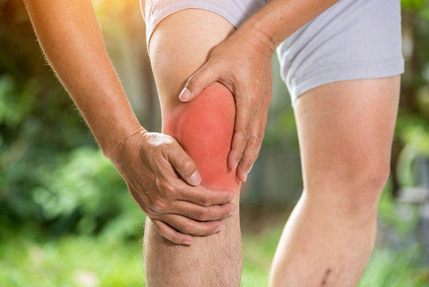
CHIEF COMPLAINTS:
Fever,
Chills,
Pain in joints,
Inflammation in knees.

Slide 4
MEDICAL HISTORY:
Nill.
SOCIAL HISTORY:
Alcoholic.

Slide 5
VITALS:
PARAMETER | DAY1 | DAY2 | DAY3
1.B.P [mm Hg] | 120/80 | 140/90 | 120/90
2.R.R | 24 | 22 | 22
3.P.R [Bpm] | 82 | 74 | 72
4.TEMP | 98.6 | 99.9 | 98.9

Slide 6
LAB INVESTIGATIONS:
PARAMETER | OBSERVED VALUE | NORMAL VALUE
Hb | 8.3g/dl | 13-16g/dl
Mean cell volume | 85.9 | 80-96
Creatinine | 0.5mg/dl | 0.6-1.2 mg/dl
Total RBC | 3.27m/cc | 4.5-6m/cc
Mean cell Hb | 24.5% | 27-32%
PCV | 22.7% | 40-52%
Uric acid | 8.9mg/dl | <6mg/dl

Slide 7
SPECIFIC TEST:
Examination of synovial fluid from inflammed joints:
Presence of ureate crystals.
DIAGNOSIS:
GOUTY ARTHRITIS.

Slide 8
TREATMENT:
DRUG | DOSE | FREQ | R.O.A | DAY 1 | DAY 2 | DAY 3
I. Tramadol | 50mg | Bid | I.V | + | + | +
Diclofenac | 30mg | qid | Oral | + | + | +
T.Omeprazole | 40mg | Bid | Oral | + | - | -
T.Febustat | 40mg | O.d | Oral | + | + | +
Vit c supplement | 90mg | O.d | Oral | + | + | +

Slide 9
SOAP NOTES

Slide 10
SUBJECTIVE:
Fever,
Chills,
Pain in joints,
Inflammation in knees.

Slide 11
OBJECTIVE:
Hb - 8.3g/dl
Total RBC - 3.27mm/cc
PCV - 22.7%
Mean cell Hb - 24.5%
Uric acid - 8.9/dl

Slide 12
ASSESMENT:
No drug interactions found.
Uric acid levels are elevated.

Slide 13
PLAN:
Prescribe antipyretic to reduce fever.
Opiod analgesics should not be consumed with NSAIDS, so change the time of administration.
NSAIDS treatment should be discontinued after symptoms are resolved.
Prophylactic anti inflammatory therapy is recommended.
Prescribe iron supplements to increase haemoglobin.

Slide 14

PATIENT COUNSELLING:

Slide 15
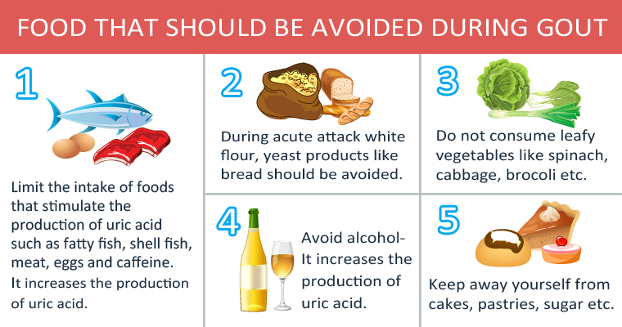
DIET:

Slide 16
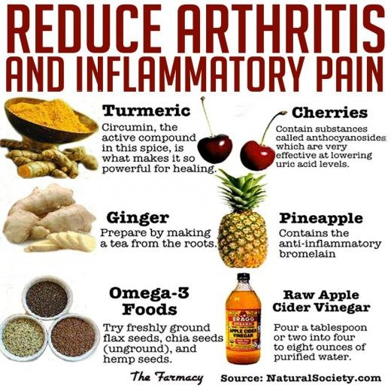

Slide 17
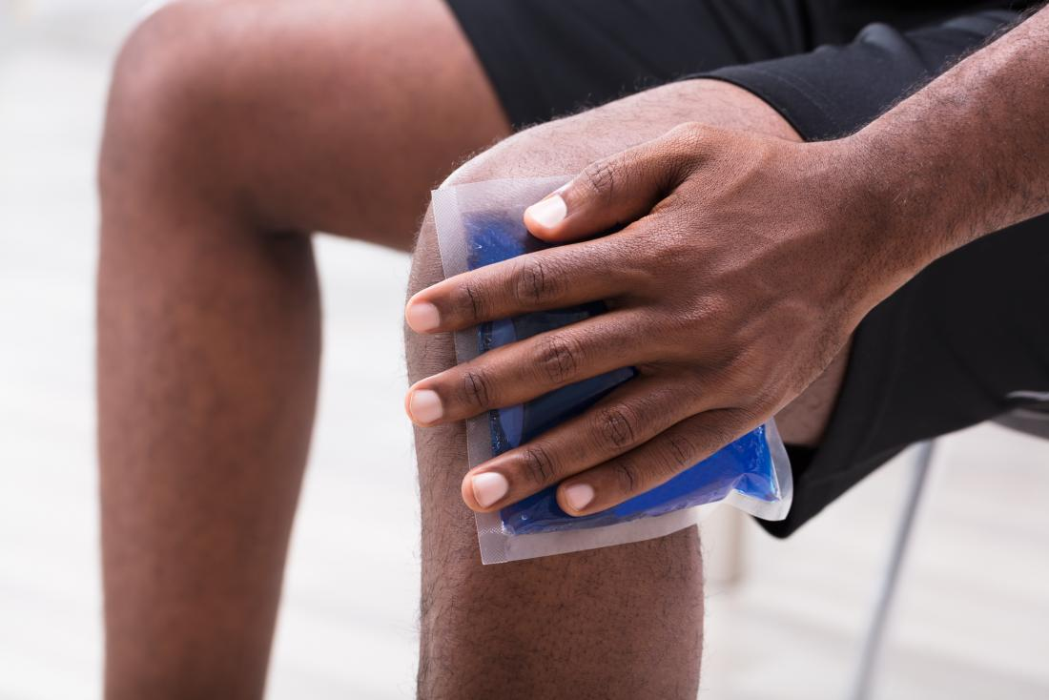
Ice packs can be helpful in relieving pain and inflammation.

Slide 18
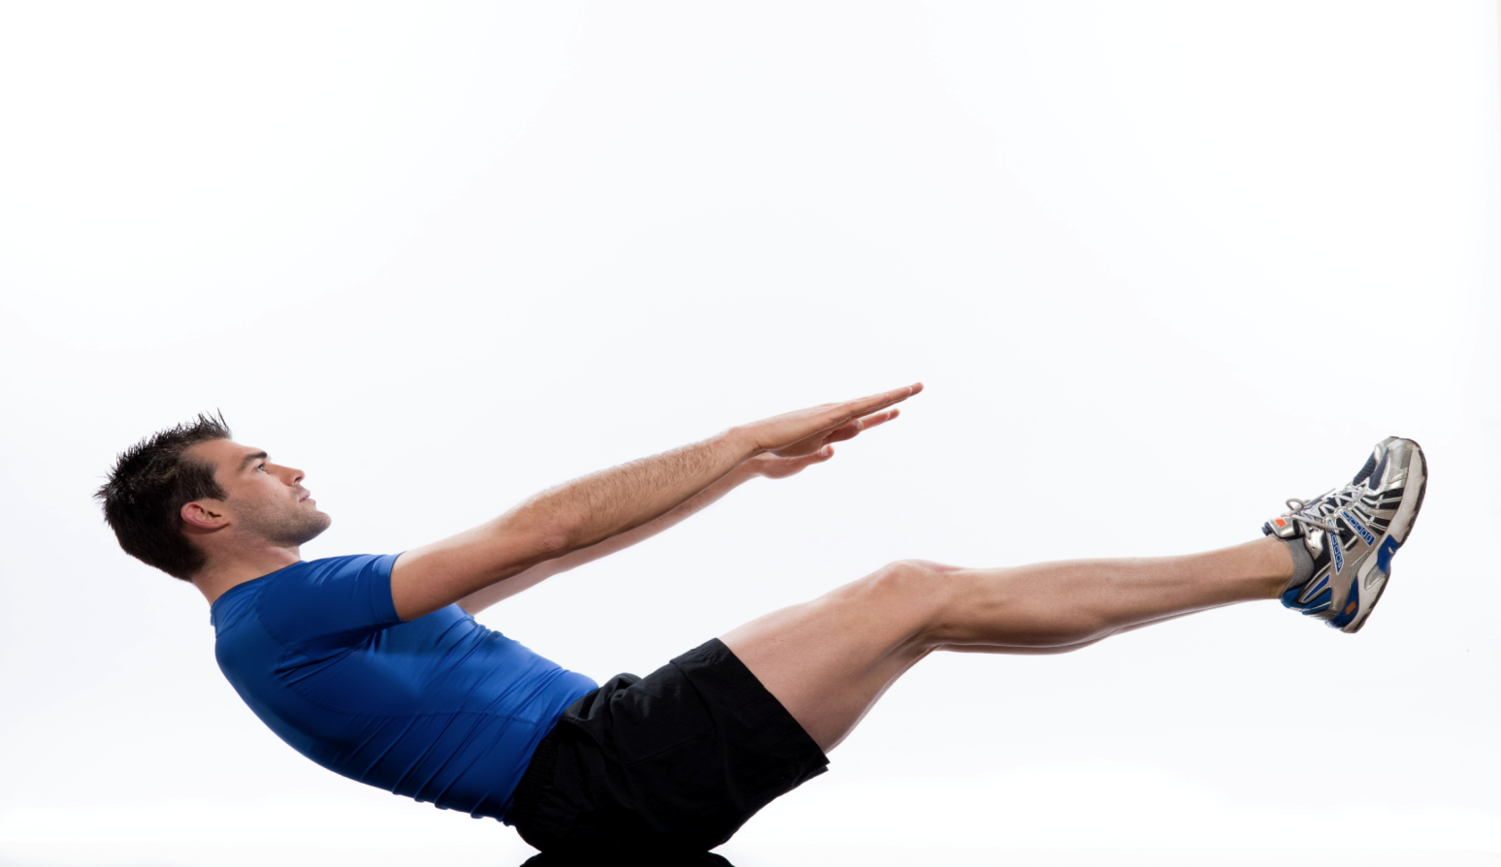
Control weight gain with daily exercise.

Slide 19
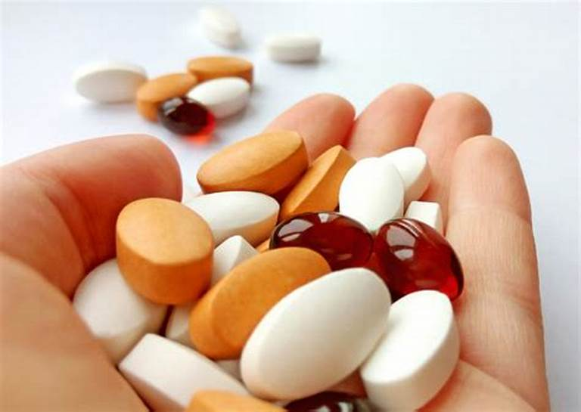
Don’t skip medications.

Slide 20


