Slide 1
Hormone Regulation of Plasma Calcium
Lopamudra Chakravarty
Assistant Professor

Slide 2
Introduction
Blood calcium regulation is simpler than other aspects of endocrinology, because parathyroid hormone regulation does not include a brain component.
Ca⁺⁺ moves freely through blood capillary endothelial membranes between blood and the interstitial fluid. Thus, the concentration of Ca⁺⁺ remains similar in blood and interstitial fluid.
Calcium enters the body regularly from the diet through the gastrointestinal tract.
When dietary calcium drops, or if the kidney’s ability to reabsorb Ca⁺⁺ after blood filtration becomes impaired, bone acts as a Ca⁺⁺ reservoir.
Crystals of bone’s calcium phosphate are broken down to maintain calcium ion’s plasma set point.
There are three molecules which regulate the amount of calcium in blood and ensure it is maintained within the normal range.
These are calcitriol (vitamin D), parathyroid hormone and calcitonin. The synthesis of calcitriol is completed in the kidneys, parathyroid hormone (PTH) is secreted by the parathyroid glands, and calcitonin is secreted by the thyroid glands.

Slide 3
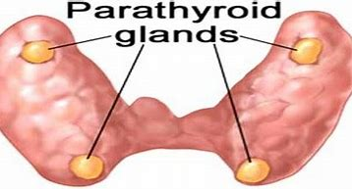
Parathyroid hormone
Parathyroid hormone is secreted by the four parathyroid glands. These tiny glands are present in the neck behind the thyroid glands.
Parathyroid hormone controls and regulates the levels of calcium in the blood and raises their levels when they are too low. This gland performs its function through its actions on the bones, intestines, and kidneys.
There are two main types of Parathyroid hormone:
Parathormone
Calcitonin

Slide 4
Parathyroid hormone
The primary purpose of parathyroid glands is to regulate calcium in the blood in a very strict range between 9.0 and 10.1 mg/dL. Parathyroids also manage the amount of calcium in the bones and determine their strength.
Bones – The parathyroid hormone (PTH) stimulates the release of calcium from stores of calcium present in the bones into the bloodstream.
Intestine – PTH increases the calcium absorption in the intestine by food through its impacts and affects the metabolism of vitamin D.
Kidneys – PTH minimizes the calcium loss in the urine and also stimulates active vitamin D formation in the kidneys.

Slide 5
Parathyroid hormone
Blood Ca⁺⁺ regulation begins at the parathyroid gland.
The rate of parathyroid hormone secretion increases above its constant basal rate when Ca⁺⁺ in plasma falls below a critical level.
Blood flow delivers parathyroid hormone to bone compartments.
Parathyroid hormone receptors in bone exist on the surface of osteoblasts, the cells that build bone. Increased parathyroid hormone stimulates osteoblast secretion of secondary molecules to trigger osteoclasts to breakdown bone’s calcium phosphate crystals.
Plasma concentrations of Ca++ and phosphate ion rise in the presence of parathyroid hormone at bone.
To prevent recrystallization of calcium phosphate, the phosphate ion must be eliminated. To accomplish this parathyroid hormone has an additional effect at the kidney. At the distal tubules and collecting duct of the nephrons parathyroid hormone inhibits reabsorption of phosphate ions back into blood.
Parathyroid hormone at the kidney also stimulates kidney conversion of the inactive form of vitamin D in blood to its active form. In turn, an increased amount of active vitamin D binds to its receptors in intestinal cells and enhances absorption of Ca++ from digested food.

Slide 6
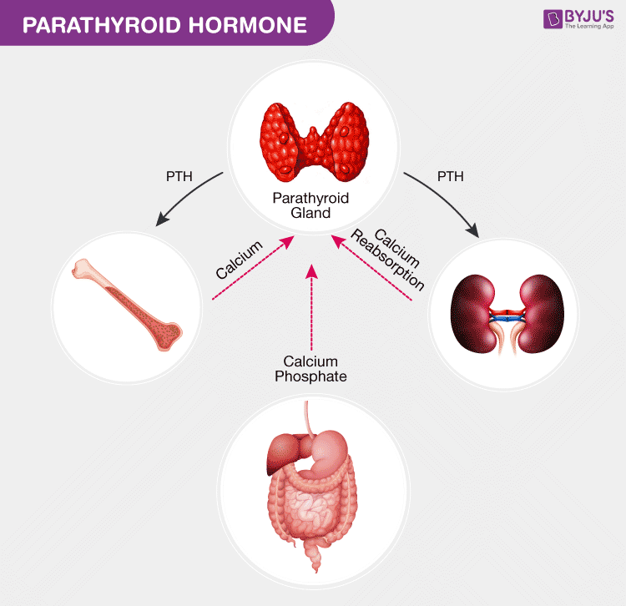
Parathyroid hormone regulation
The cells of the parathyroid gland have a receptor on their surface for binding Ca⁺⁺. This calcium-sensing receptor connects to intracellular pathways regulating the synthesis of parathyroid hormone. When interstitial fluid Ca⁺⁺ rises above 10 mg/dl due to bone re-absorption and increased uptake from the intestine, calcium-sensing receptor activity slows parathyroid hormone synthesis and release. Parathyroid hormone falls to its low basal level in blood.
The adjacent thyroid gland also produces a hormone named calcitonin. Calcitonin works in opposition to parathyroid hormone to lower plasma Ca⁺⁺ when it is too high. While calcitonin paired with parathyroid hormone remains an important regulator of plasma Ca⁺⁺. It inhibits osteoclast activity by binding to a receptor embedded in the osteoclast membrane. And, it inhibits re-absorption of Ca⁺⁺ and phosphate ion.

Slide 7
What if the parathyroid hormone is too high?
Hyperparathyroidism is an endocrine disorder which causes over secretion of parathyroid hormone in the body. This over secretion of PTH causes an abnormal rise in the blood calcium levels.
Over secretion of parathyroid hormone can make a person depressed, irritable, insomnia, memory loss, lack of energy and worried are the most common symptoms in patients with parathyroid disease.
It is of three types.
Primary hyperparathyroidism
Secondary hyperparathyroidism
Tertiary hyperparathyroidism
In primary and tertiary hyperparathyroidism, the level of calcium is high due to excessive secretion of parathyroid hormone.
In secondary hyperparathyroidism, the level of calcium is low due to other factors like kidney disease.

Slide 8
What if the parathyroid hormone is too little?
Hypoparathyroidism is a rare condition in which there is low production of parathyroid hormone in the body this condition results in abnormally low levels of calcium in the blood. It is treated medically with vitamin D analogues and oral calcium supplements.
When the calcium level falls down people get a tingling sensation or cramps in the hand muscles. A sudden drop can cause an individual to feel weird, foggy and the brain not functioning accurately.

Slide 9
Calcitonin
Calcitonin is a hormone that is produced in humans by the parafollicular cells (commonly known as C-cells) of the thyroid gland' . Calcitonin is involved in helping to regulate levels of calcium and phosphate in the blood, opposing the action of parathyroid hormone. This means that it acts to reduce calcium levels in the blood.
Calcitonin reduces calcium levels in the blood by two main mechanisms:
It inhibits the activity of osteoclasts, which are the cells responsible for breaking down bone. When bone is broken down, the calcium contained in the bone is released into the bloodstream. Therefore, the inhibition of the osteoclasts by calcitonin directly reduces the amount of calcium released into the blood. However, this inhibition has been shown to be short-lived.
It can also decrease the resorption of calcium in the kidneys, again leading to lower blood calcium levels.
Manufactured forms of calcitonin have, in the past, been given to treat Paget’s disease of bone and sometimes hypercalcaemia and bone pain. However, with the introduction of newer drugs, such as bisphosphonates, their use is now very limited.

Slide 10
Regulation
The secretion of both calcitonin and parathyroid hormone is determined by the level of calcium in the blood. When levels of calcium in the blood increase, calcitonin is secreted in higher quantities. When levels of calcium in the blood decrease, this causes the amount of calcitonin secreted to decrease too.
The secretion of calcitonin is also inhibited by the hormone somatostatin, which can also be released by the C-cells in the thyroid gland.

Slide 11
What happens if I have too much calcitonin?
There does not seem to be any direct deleterious effect on the body as a result of having too much calcitonin.
Medullary thyroid cancer is a rare type of cancer that arises from the C-cells in the thyroid gland that secrete calcitonin. It is sometimes associated with multiple endocrine neoplasia.
Patients with medullary thyroid cancer have high calcitonin levels in their bloodstream.
However, it is important to note that these high calcitonin levels are a consequence of this condition, not a direct causal factor.

Slide 12
What happens if I have too little calcitonin?
There does not seem to be any clinical effect on the body as a result of having too little calcitonin. Patients who have had their thyroid gland removed, and have undetectable levels of calcitonin in their blood, show no adverse symptoms or signs as a result of this.

Slide 13
Vitamin-D
Vitamin D is a group of fat-soluble steroids responsible for increasing intestinal absorption of calcium, magnesium, and phosphate, and many other biological effects.
In humans, the most important compounds in this group are vitamin D₃ (cholecalciferol) and vitamin D₂ (ergocalciferol).
The major natural source of the vitamin is synthesis of cholecalciferol in the lower layers of epidermis of the skin through a chemical reaction that is dependent on sun exposure (specifically UV radiation).
Cholecalciferol and ergocalciferol can be ingested from the diet and supplements. Only a few foods, such as the flesh of fatty fish, naturally contain significant amounts of vitamin D.
Vitamin D has a significant role in calcium homeostasis and metabolism

Slide 14
Properties of Vitamin D
  Vitamin D is a white and almost odourless crystalline substance.
  It is soluble in fat and fat solvents.
  It is fairly heat resistant and also relatively resistant to oxidation.
  It is not affected by acids and alkalies.

Slide 15
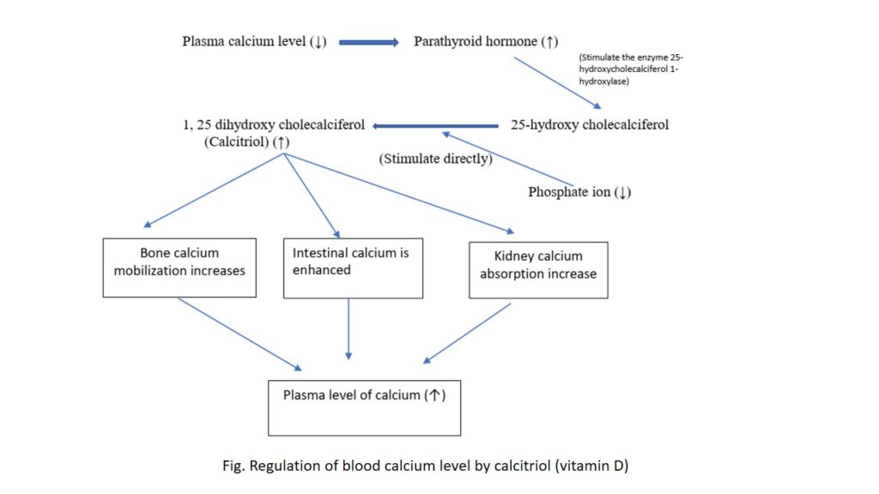
Regulation of blood calcium level by calcitriol:
Plasma level of calcium and phosphorus regulate the activity of calcitriol formation which in turn maintains the calcium level of plasma.

Slide 16
Biological role of Vitamin D
The major function of vitamin D is to maintain the plasma level of calcium and phosphorus.
Calcitriol functions by acting on three major sites:
i. Action in intestine
Vitamin D (Calcitriol) stimulate the calcium absorption in the intestine.
Calcitriol in intestinal cells bind to the calcitriol receptor forming calcitriol receptor complex.
This calcitriol acts on nucleus stimulating the DNA to produce mRNA and therefore protein called calcium binding protein.
This calcium binding protein binds and absorbs the calcium.
ii. Action in bone
Calcium is very essential for bone formation.
Calcitriol stimulates calcium absorption and deposition as calcium phosphate.
Calcium along with parathyroid hormone mobilizes the calcium and phosphate from bone.
iii. Action in kidney:
Calcitriol along with parathyroid hormone inhibits the calcium excretion from kidney, meanwhile, calcitriol also stimulates the reabsorption of calcium from renal tubules.

Slide 17
Dietary sources of vitamin D
Fatty fish, fish liver oil, egg yolk
vitamin D is also obtained by consumption of irradiated food (irradiated yeast) and exposure to sunlight.

Slide 18
Vitamin D deficiency:
Vitamin D deficiency occur due to inadequate exposure to sunlight and inadequate consumption of Vitamin D diet.
Vitamin D deficiency occurs in strict vegetarians, chronic alcoholic, liver and kidney disease and mal-absorption.
Deficiency results in rickets in children, a condition that is characterized by incomplete mineralization that result in soft and pliable bone and delay in teeth formation.
In adults deficiency leads to osteomalacia, a condition involving softening of bone.
This results from bone demineralization.
Bones are highly susceptible for fracture.
Renal rickets can occur in individual with renal failure due to decreased synthesis of calcitriol.
Hypervitaminosis D:
Excessive vitamin D at more than rate 100 times required RDA results in hypervitaminosis of Vitamin D.
Excessive vitamin D can result in nausea, loss of appetite, loss of body weight.

Slide 19
Thank you my dear students

